Slide 1
COVID Staffing Collaborative
URL covidstaffing.org
@COVIDstaffing
https://files.slack.com/files-pri/T010YR96T6U-F010PTWQM9P/covid-staffing-greyscale.png
March 29, 2020

Slide 2
Who We Are
Content expert:
Kyla Terhune MD MBA, DIO at Vanderbilt University
Collaborating groups:
University of Michigan’s Center for Surgical Training and Research (C-STAR)
University of Michigan’s Department of Learning Health Sciences
Procedural Learning and Safety Collaborative (PLSC)

Slide 3
Defining the Problem
In the face of the COVID-19 pandemic many hospitals are challenged to categorize and redeploy their clinical staff to meet rapidly progressive patient needs.
They must do so in a way that can adapt to dynamic workforce availability.

Slide 4
Defining the Gap
To confront these challenges, health systems must:
Inventory the skills and training of their providers
Assess current and projected patient volume
Predict clinical staff availability accounting for up-training, workforce illness and quarantine restrictions
Assign providers to clinical teams as needs change

Slide 5
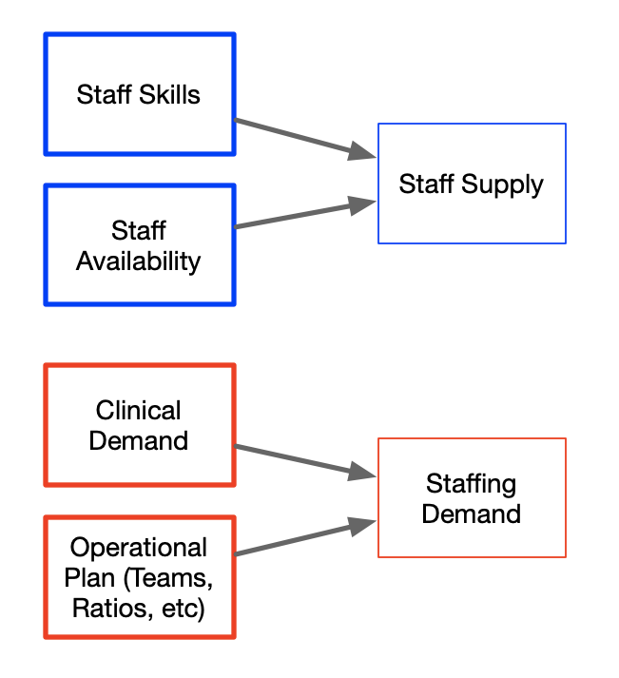
Key Insight #1
This can be conceptualized as a supply vs. demand problem.
Staff supply is a function of the staff’s existing skills and availability plus the effects of training, illness, and fatigue over time
Staff demand is a function of current and projected patient needs and a system’s operational structure, i.e. team structure, staffing ratios, unit designations, etc.

Slide 6
Key Insight #2
ICU intern
Floor attending
Floor resident/APP
Floor intern
Procedure attending
Procedure resident
Airway attending
Airway resident
ER triage/screen
Nursing Assistant/LPN
Care Partner
Respiratory Therapist
Staffing allocations should be made based on defined “Roles” (i.e. independent instensivist, critical care RN, etc)
These are distinct from skills (ventilator management) and positions (attending, resident, RN)

Slide 7
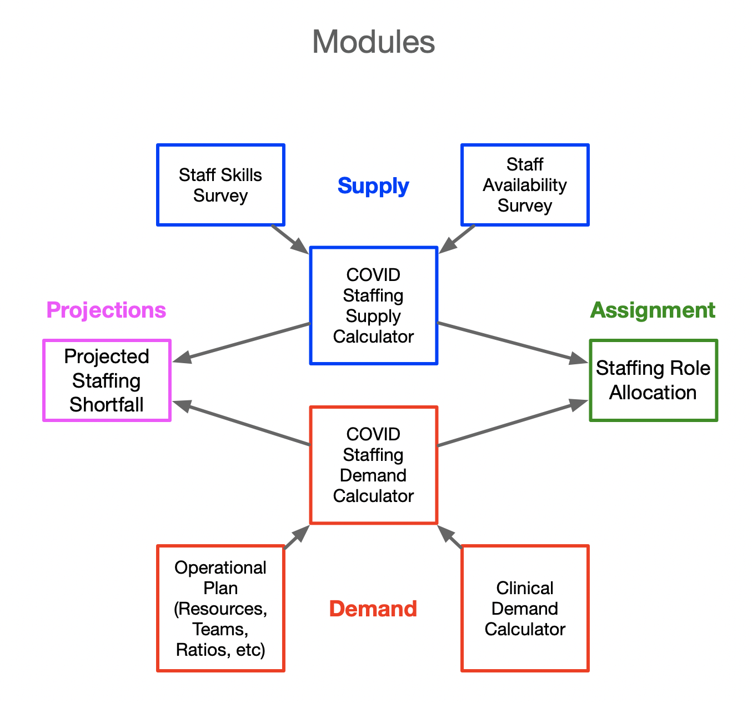
Roadmap
We are building several tools to support these processes, to be released over the course of the next few days
These tools will be designed to work in tandem once fully implemented

Slide 8
Our first tools: COVID Roles for Providers
Faculty Skills Survey
Faculty Role Allocation
COVID Response Staff Role Inventory
Trainee Education-Based Re-deployment Module
Our tool helps organizations collect data about individual providers’ training and skills as well as their willingness to care for COVID patients.
Based on that data the tool will automatically map those providers to specific clinical roles they might play in an institutional pandemic response plan.
Launched at http://www.covidstaffing.org

Slide 9
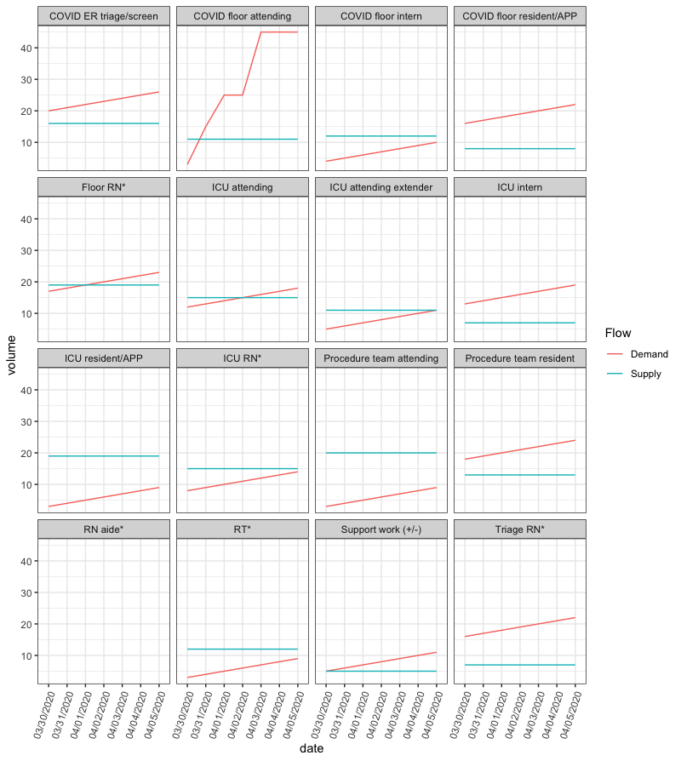
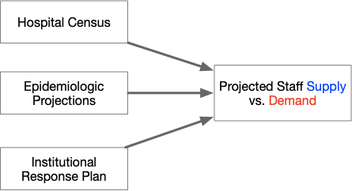
Next tool: Institutional Demand Projections
Launching this week at http://www.covidstaffing.org

Slide 10
How you can help
We are rapidly building tools to support workforce redeployment processes
We need help disseminating these no-cost tools
We are also seeking other collaborators to accelerate this work
info@covidstaffing.org

